Slide 1

Zero to Hero:
Visual Studio Code for Embedded Linux Development
Presented by Toradex
Notes:
Welcome everyone to this webinar hosted by Toradex, entitled: Zero to Hero: Visual Studio Code for Embedded Linux Development

Slide 2

WITH YOU TODAY…
Valter Minute
Senior Software Engineer
Toradex
Notes:
My name is Valter Minute and I am a Senior Software Engineer at Toradex.
Before diving into the webinar, let me cover a few organizational points….
Please use the Chat window of the webinar tool if you have any technical issues and wish to let us know.
At the end, we will also do an interactive Question Answer Session, you can type your questions in the Chat window any time, and we will pick them up at the end.
The webinar will be recorded and made available for on-demand viewing.
With this, let's get started..

Slide 3


WHAT WE DO
Make Embedded Computing Easy
Reliable Arm® System on Modules
Lowest Cost of Ownership
Industry-leading Support
RELIABLE AND EASY-TO-USE EMBEDDED SOLUTIONS FOR YOU
Notes:
I will begin with a very brief overview who Toradex is what we do.
Toradex is focusing on making embedded computing easy-to-use. So you can get simple access to the latest technology for your product development
We are doing so by providing highly reliable Arm System on Modules (SoMs), including software and support.
We are striving to offer the lowest cost of ownership to you, and this doesn’t just mean the module price, but also consideration of aspects like your development effort, time-to-market, and long-term maintenance.
We are proud of being able to have industry-leading support, including a very active community and a developer page with over 800 articles with is updated daily.
As you can see, we have offices around the world with local support and warehouses.

Slide 4
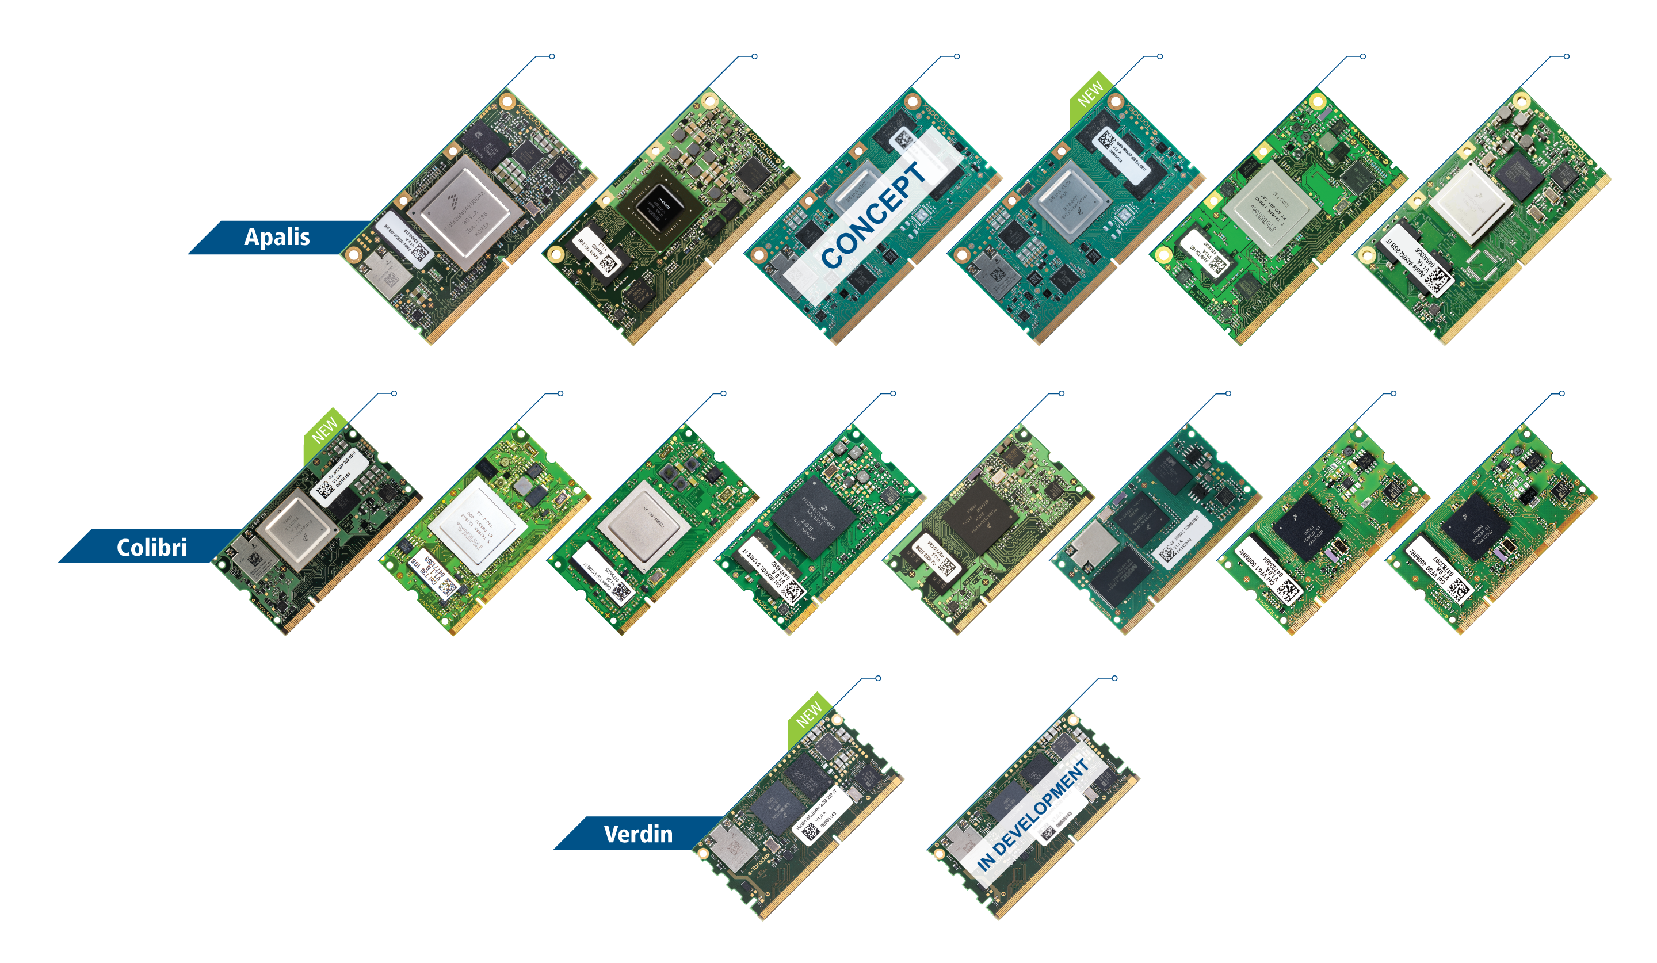











PRODUCT PORTFOLIO
Apalis iMX8
Apalis TK1
CONCEPT
Apalis iMX8M Plus
Apalis iMX8X
Apalis T30
Apalis iMX6
Colibri iMX8X
Colibri T30
Colibri T20
Colibri iMX6
Colibri iMX7
Colibri iMX6ULL
Colibri VF61
Colibri VF50
IN DEVELOPMENT
Verdin iMX8M Mini
Verdin iMX8M Plus
Introducing Verdin
Notes:
Here is a short overview of our products.
We have 3 SoM Families. Inside these families, the modules are pin compatible. So you can seamlessly scale from i.MX 6, over i.MX 7 to the i.MX 8s
We are also providing production-quality SW with these modules. But you will learn more about our products later.

Slide 5

TYPICAL APPLICATIONS
TOP MARKETS
Industrial Automation
Healthcare
Transportation
Test & Measurement
Smart City
ANNUAL VOLUMES
100 to 50k
Notes:
I’d also like to explain our Focus Applications, as we are optimizing our products and offerings for them
Industrial Automation
Healthcare
Transportation
Test & Measurement
Smart City
Typical Projects are customers with volume requirements of a few 100s to a few 10,000s products per year. Toradex itself has 1,000s of active customers.

Slide 6




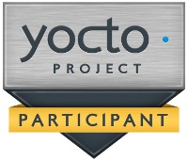
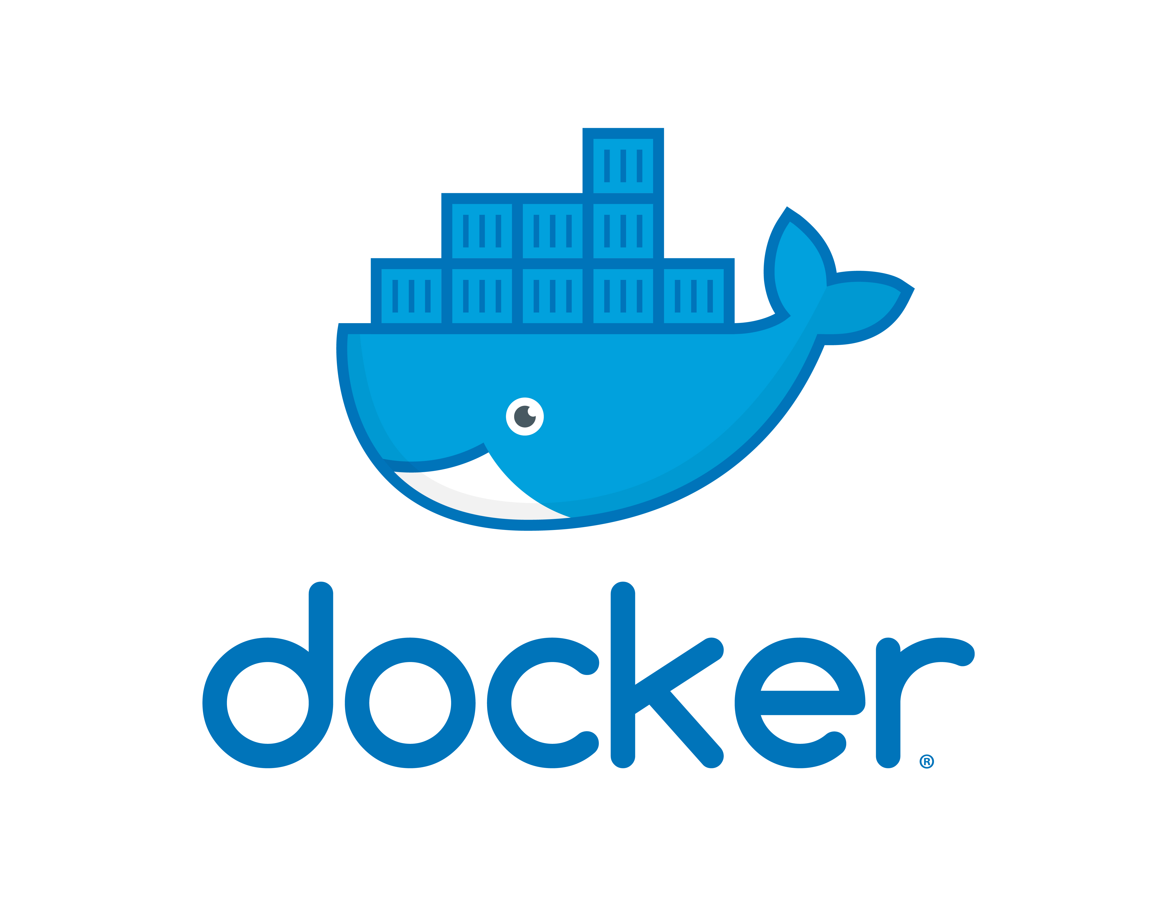



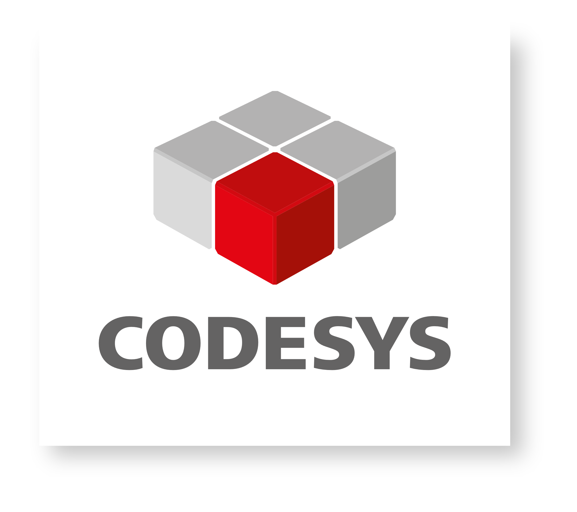
Easy-to-use Industrial Linux Software Platform
Fast time-to-market
Ready-to-use Linux distribution
Open Source
Based on open software, No lock-in
Simple updates
Built-in, automotive-grade, over-the-air update capabilities
Secure
Frequent updates, accessible security features
Real-time
Optimized real-time option
Notes:
Apart from the highly reliable system on modules, Toradex also provides production-ready software, including reference images for the yocto project. Toradex is also active in mainlining code for its System on Modules.
Torizon is a brand-new free offering from Toradex, its an open-source and easy to industrial Linux Platform.
It focuses on lowering your time-to-market and can be used out-of-the-box.
It’s based on open software so you have no lock-in and you can adjust it to your needs.
Torizon comes with an automotive-grade updated client to allow for simple, safe, and secure software updates. As an example Software updates are safe even if you lose power in the worst possible moment.
Security is another focus, frequent updates, and simple access to hardware security features that make it easy for you to develop a secure device.
A real-time option is available.
Modern continuous integration and verification processes make sure every Torizon release is stable.
Torizon is built with the Yocto Project and utilizes Docker for software containerization, tapping into a vast software ecosystem.

Slide 7
VISUAL STUDIO CODE

Slide 8

Q&A

Slide 9
THANK YOU
FOR YOUR INTEREST
www.toradex.com
developer.toradex.com
community.toradex.com
labs.toradex.com

